Slide 1
Capstone 2: Comparisons of Multi-classification Models for Pancreatic Cancer Prediction
By Linmin Wang
March 24th 2021

Slide 2
Background of Pancreatic Cancer
43.9%
Deadliest: Extremely low 5-year survival rate
Hard to detect: Lacks Characteristic Biomarkers^{[2]}
89.7%
18.1%
64.9%
24th
8.2%
With Machine Learning:
Detection via Urinary Biomarkers in Early Stage
Beneficial in Clinical Application
[1] Seer.cancer.gov. URL: https://seer.cancer.gov/archive/csr/1975_2014/browse_csr.php?sectionSEL=1&pageSEL=sect_01_table.01
[2] T. Crnogorac-Jurcevic et al.

Slide 3
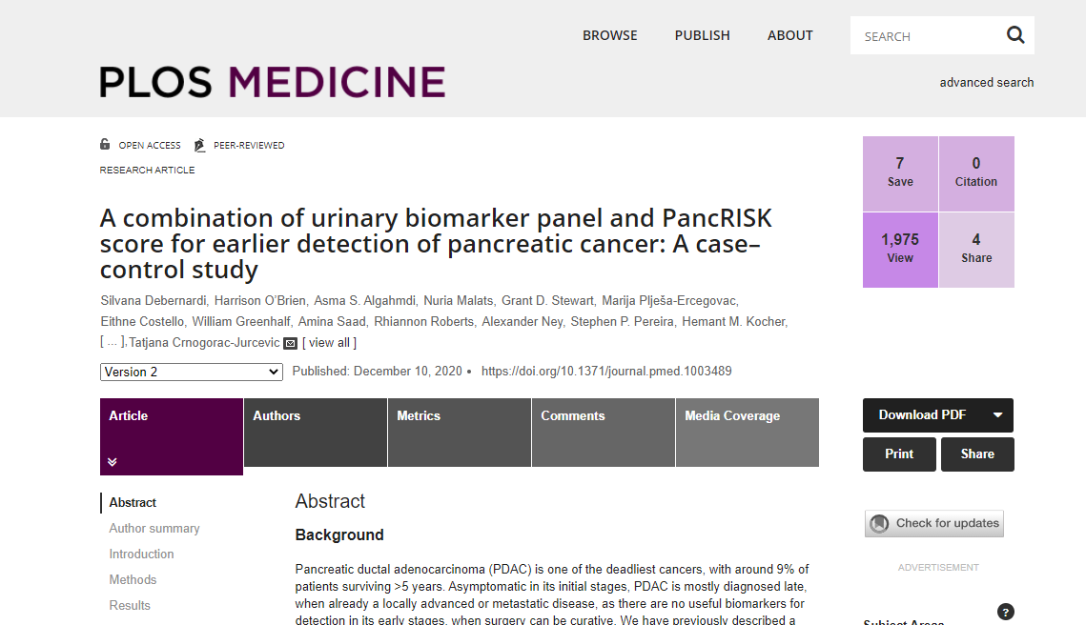
Dataset

Slide 4
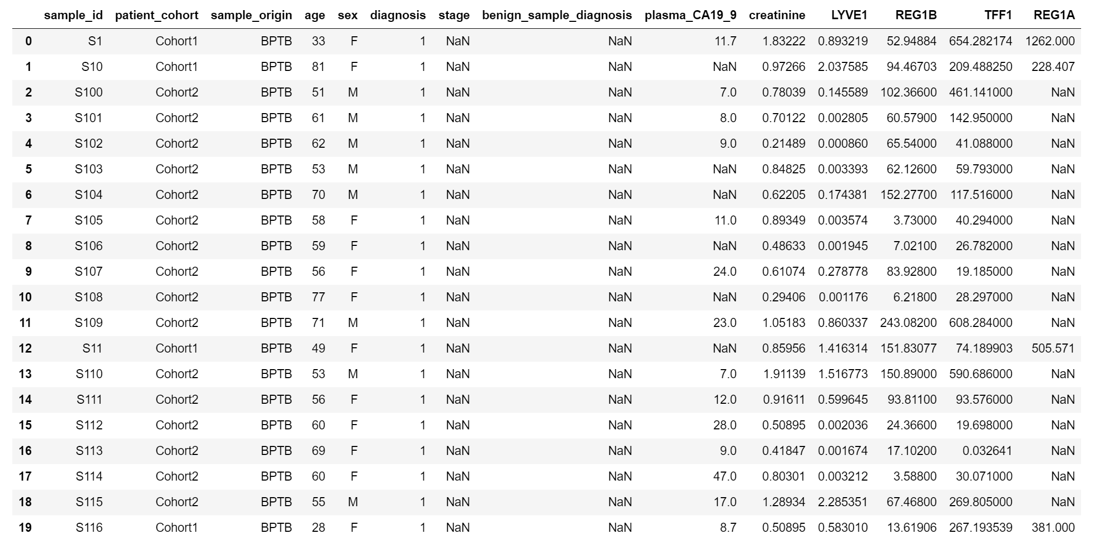
Dataset
1: Healthy
2: Pancreatic Disease
3: Pancreatic Cancer
Target
Features
Features: Urinary Biomarkers
590

Slide 5
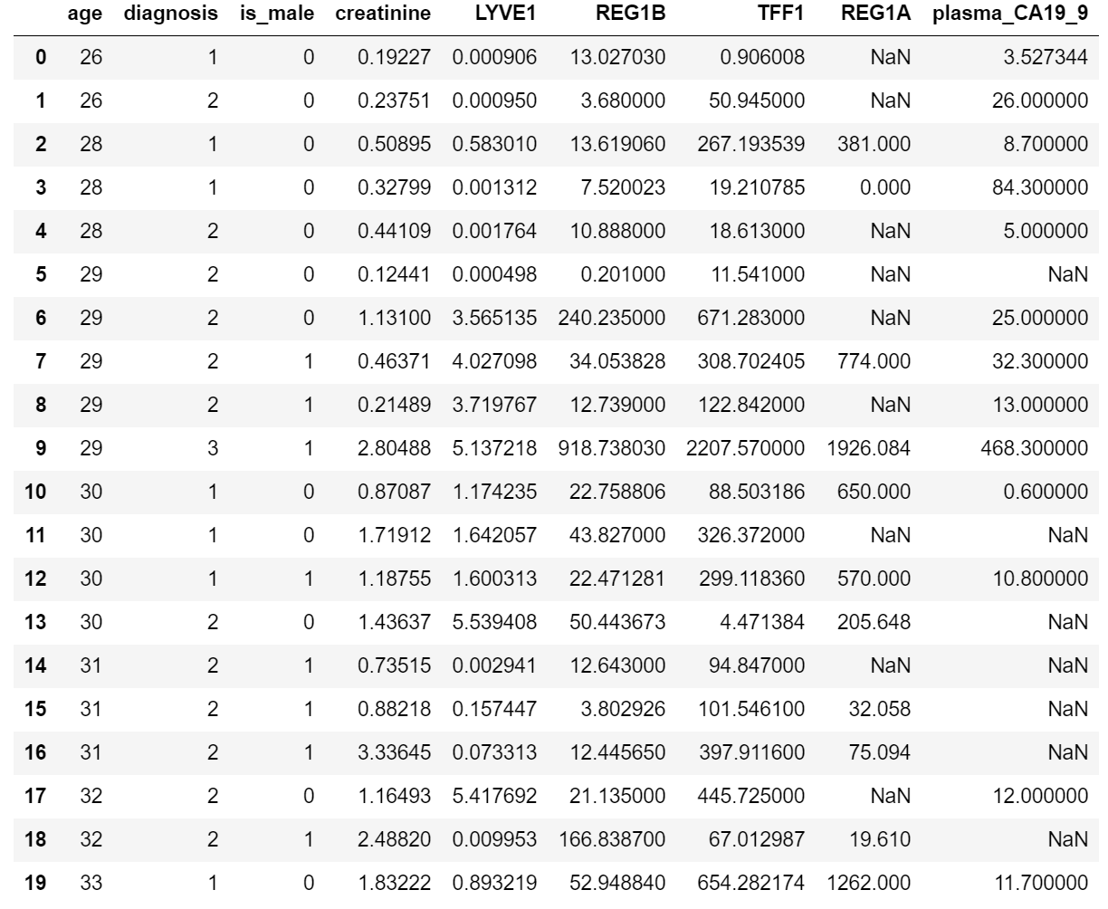
Filling the Nulls
Average
About 48.1% of “REG1A” and 40.7% of “plasma_CA19_9” missing
Fill in the nulls with the average values from patients of identical diagnosis, sex and closest ages

Slide 6
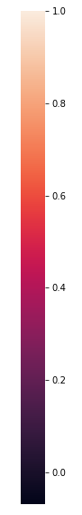
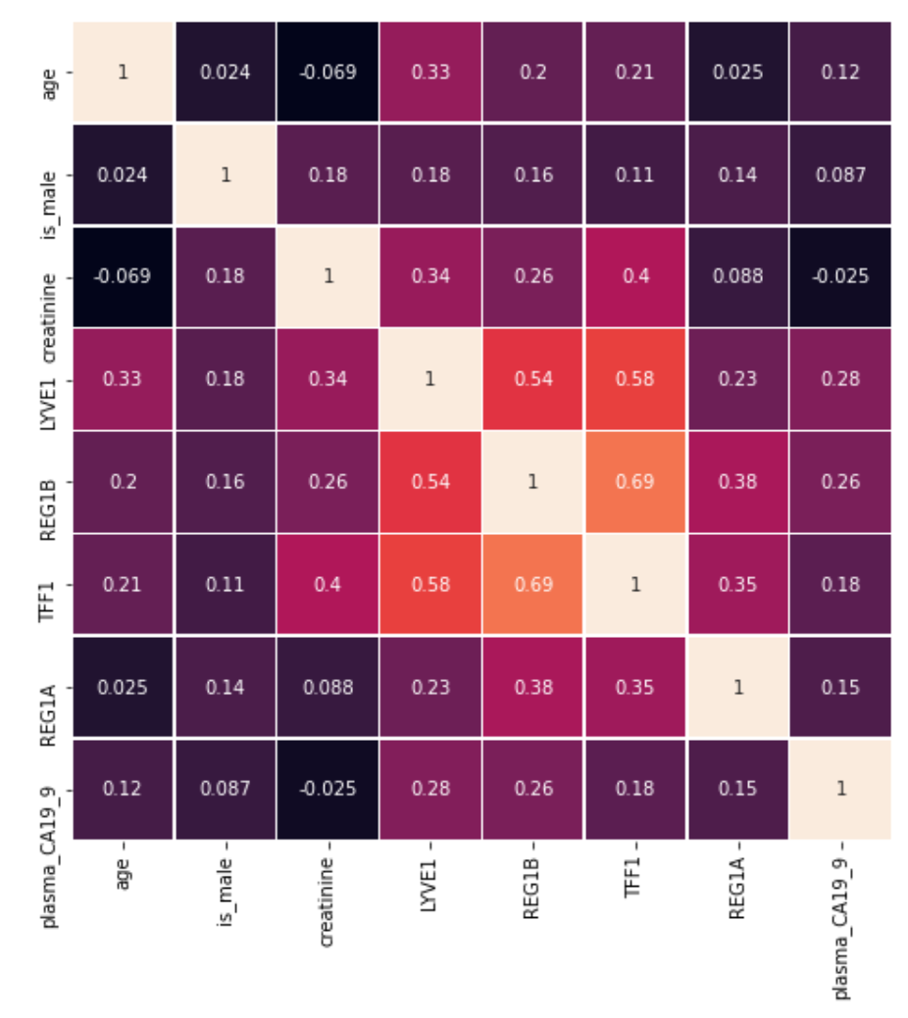
Correlation Heat Map
Urinary Biomarkers
Generally weak to no correlations except urinary biomarkers

Slide 7
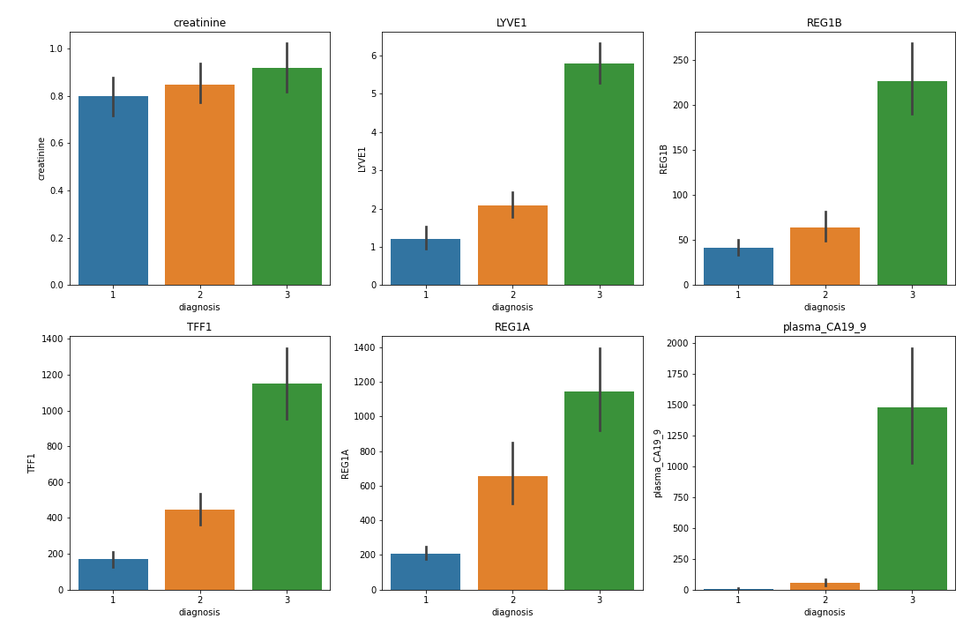
Bar Diagrams Urinary Biomarkers with Respect to “Diagnosis”
Diagnosis:
1: Healthy
2: Pancreatic Disease
3: Pancreatic Cancer
Urinary biomarkers tend to increase with deteriorating pancreatic conditions

Slide 8
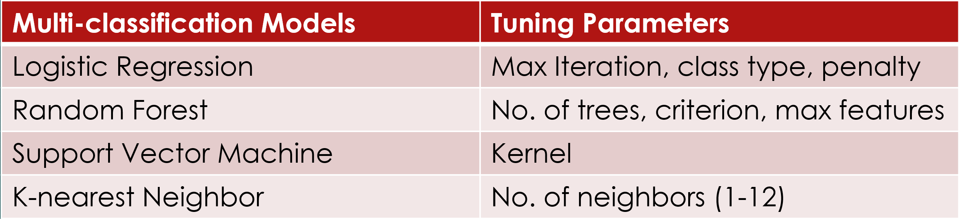
Methods: Models and Hyperparameter Tuning
Optimize average accuracies and standard deviation of a 5-fold cross validation while tuning parameters
Comparison of models via confusion matrices and classification reports

Slide 9
Comparisons and Results
 | Average Accuracy | Standard Deviation | Recall (Cancer Case)
Logistic Regression | 0.693 | 0.068 | 0.81
Random Forest | 0.689 | 0.068 | 0.79
Support Vector Machine | 0.702 | 0.071 | 0.85
K-nearest Neighbor | 0.625 | 0.048 | 0.75
Dummy Model (Most frequent) | 0.353 | 0.0041 | 0.31

Slide 10
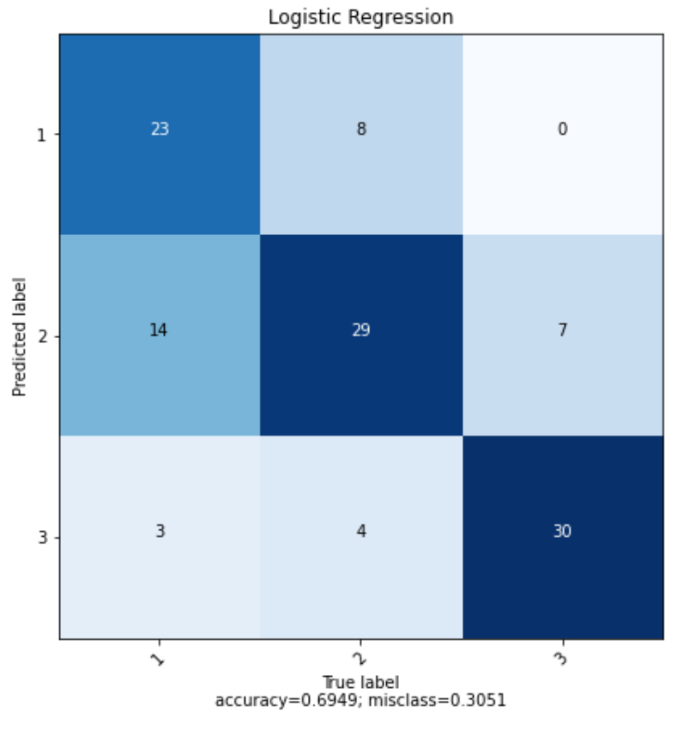
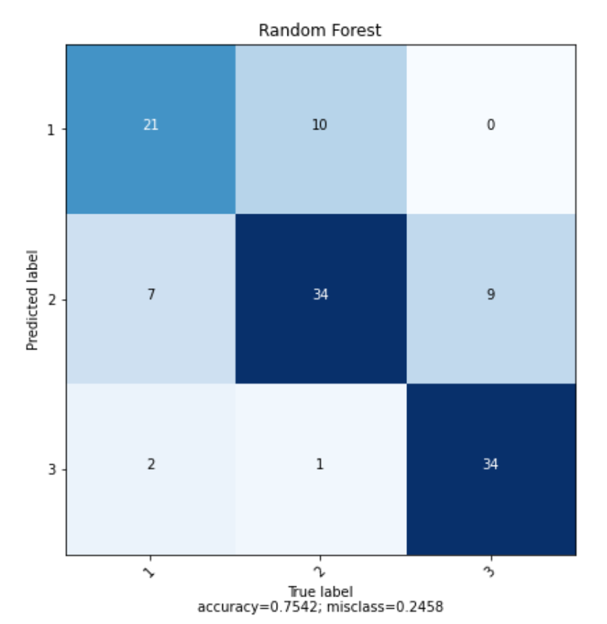
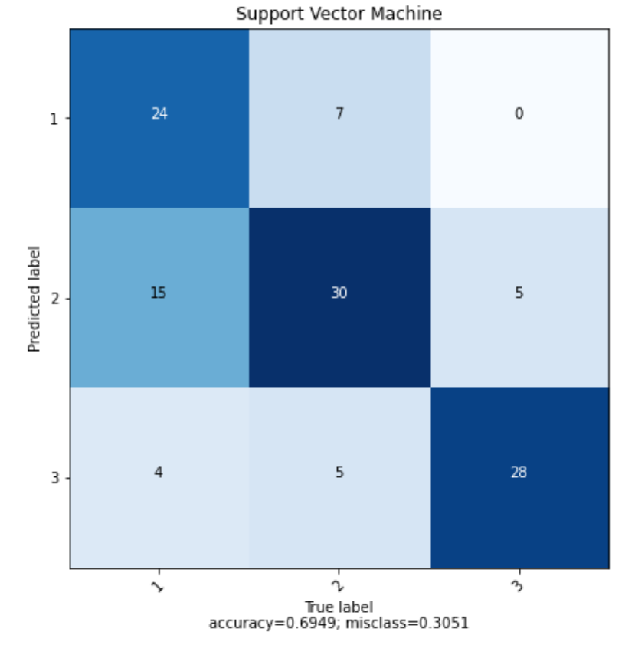
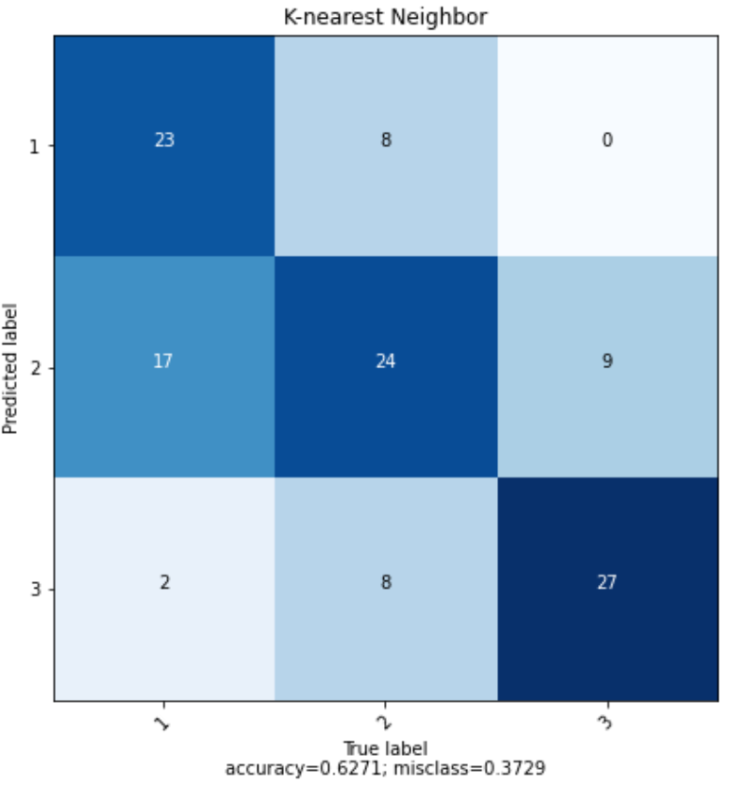
Drawbacks via Confusion Matrices
Logistic Regression
Random Forest
Prediction
Support Vector Machine
K-nearest Neighbors
Diagnosis:
1: Healthy
2: Pancreatic Disease
3: Pancreatic Cancer
True Labels

Slide 11
Conclusions
Thee models LR (0.693), RF (0.689) and SVM (0.702) outperform KNN (0.625) and Dummy model (0.353) by a huge margin
SVM does the best job considering average accuracy, standard deviation and recall (cancer case)
Future works required to better distinguish the healthy and pancreatic disease groups (increasing recall for healthy group)

Slide 12
Thank you!

Slide 13
Backup slides:
Multi-classification Models | Tuning Parameters
Logistic Regression | Max Iteration, class type, penalty
Random Forest | No. of trees, criterion, max features
Support Vector Machine | Kernel (linear, poly,sigmoid)
K-nearest Neighbor | No. of neighbors (1-12)

